Slide 1
Seasonality in Dynamic Stochastic Block Models
Jace Robinson and Derek Doran
Dept. Computer Science and Engineering
Kno.e.sis Research Center
Wright State University. Dayton, OH
CMDWM Workshop of WI ‘17
*Supported by National Science Foundation I/UCRC Center for Surveillance Research and the Air Force Research Laboratories
Main Idea
Methods
Experiments
Notes:
Hi my name is Jace Robinson and I am a second year master’s student who intends to pursue a PhD! This work is with my advisor Dr. Derek Doran. I will be presenting our work on seasonality in dynamic stochastic block models.

Slide 2
Time varying complex systems are everywhere!
OSU Geospatial Network (AFRL CLIF007)
Stehlé (2011)
Main Idea
Methods
Experiments
Notes:
Complex systems occur in many aspects of daily life. In a first example we look at a geospatial network on Ohio State University’s campus. Using a wide area motion imagery camera, we are able to see several moving targets within the city over a 14 minute period. The one dots represent the trajectories of targets, while the red dots show inferred points of interest. In a second complex system example, we examine a dynamic social network of communication of grade school students. Each vertex is a student, each edge represent face to face communication between the two students during a small time window. Both of these complex systems have the common the difficulty of extracting meaningful information from the dynamics of the system. Our work is an effort to extract meaningful patterns from the data use a statistical dynamic random network approach.

Slide 3
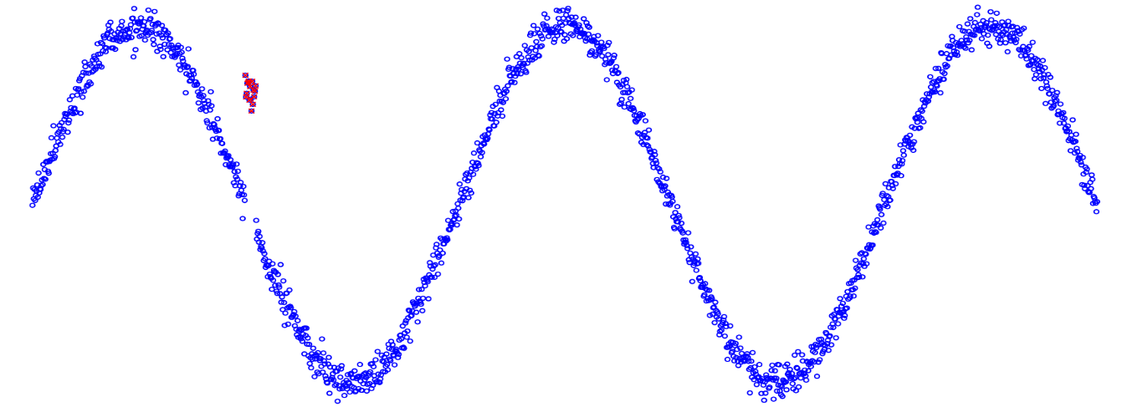
Dynamic Network Representation
Fixed vertices, time dependent edges
E.g. movement between points of interest
Communication in school
Statistical representation of edge formation with time
Anomaly detection
Edge prediction
Main Idea
Methods
Experiments
Notes:
This slide was hidden during presentation due to time constraints, but sets up the use of dynamic networks and the expected applications of statistical network representation for anomaly detection and edge prediction.

Slide 4
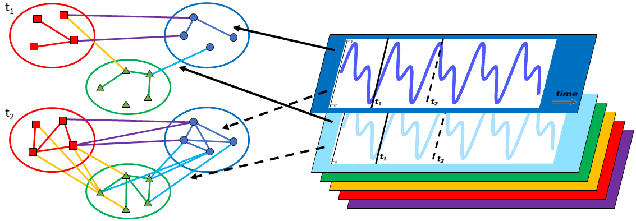
Model Assumptions
Fixed vertices fall into one of k fixed and known types
Residential, business, 2nd grader, 3rd grader
Probability of edge formation at discrete time t depends on types of incident nodes and current time
Time dependencies driven by seasonal processes
Main Idea
Methods
Experiments
Notes:
We will be using a dynamic network based approach to the problem. We assume the vertices are fixed with time, and have one of k fixed and known types. In a geospatial network, vertices could be points of interest, and types could be residential or business. Edges would represent targets moving between two points of interest in a time window. We argue it is reasonable to assume all points of interest of type residence, will cause similar movement patterns at a given time. In the overview figure below, the types of vertices are represented by the three colors, red, green and blue. The dynamic part of the network is when edges are formed. We assume the probability of edge formation at a discrete time t, depends on the types of incident nodes and current time. In the three class undirected network, we can see there are would be six different types of edges as shown by the six colors. The probability of edge formation of each type across time follows a seasonal process as shown by the curves on the right. A seasonal process is a pattern with repeats itself over regular time intervals. When the value of the seasonal process is low as shown at t1, the density of edges will be low. When the value is high as shown at t2, the density of edges will be high. For example the temperature in the four seasons of the year, repeat year to year. In traffic, over a 24 hour period, we can expect similar traffic trends day to day, such as a rush hour in the morning around 8am when people are going to work, another rush hour at end of work day at 5pm, and very light traffic in the night at 1am.
Combining this seasonal process into a random network model is the main motivation and contribution of our work. In the remainder of the talk, I walk through the methodology, defining the model in detail, and show the results on initial synthetic experiments. We have yet to complete experiments on real datasets.

Slide 5
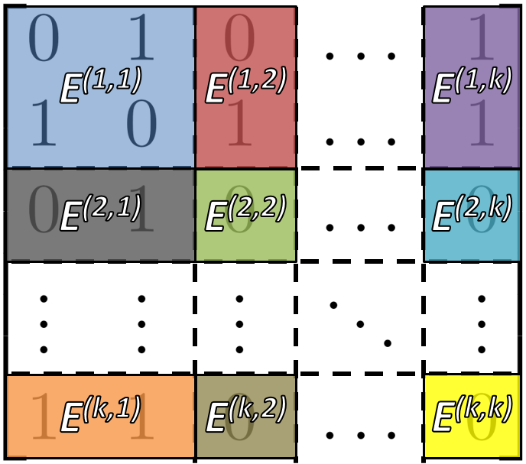
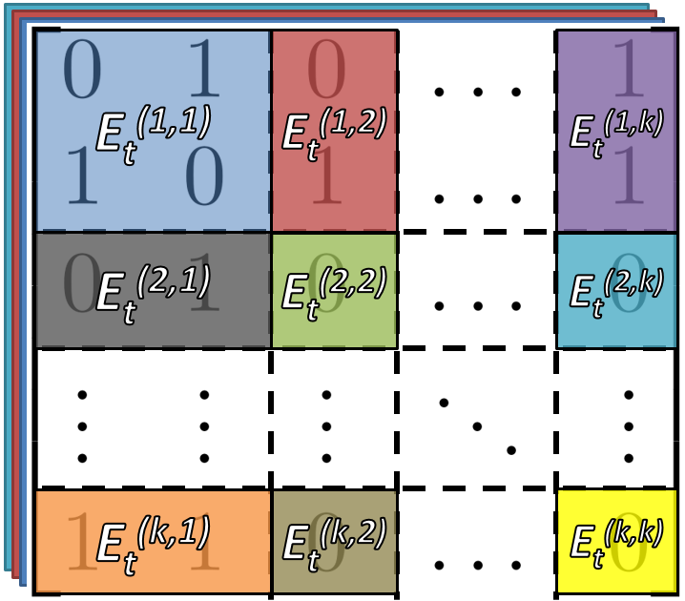
Preliminaries – Stochastic Block Model
Static Stochastic Block Model (Holland 1983)
Network in adjacency A
Each vertex v_{i} has one of k types
E is k x k block density matrix in [0,1]
If v_{i} has type a, v_{j} has type b, then
[A^{(a,b)}]_{ij} ~ Bernoulli(E^{(a,b)})
Dynamic Stochastic Block Models (Xu 13, Yang 11)
Network per time step {A₁, A₂, …, A_{T}}
Time varying block density {E_{1,} E₂, …, E_{T}}
[A_{t}^{(a,b)}]_{ij} ~ Bernoulli(E_{t}^{(a,b)})
Our novel contribution is how we incorporate the time dependency
Main Idea
Methods
Experiments
Notes:
Formally our seasonal dynamic stochastic block model is built off of the old static stochastic block model from the 80s. Using the conventional network representation of an adjacency matrix, where each index represent a vertex pair, where it is 1 if the edge exists, and 0 if it does not. In the figure on the right, this is shown as the ‘bottom layer’ underneath the colored panels. Next we define E a k x k block density matrix, where each value is in the range [0,1]. The probability of edge formation is the defined as if v_i has type a, v_j has type b, then edges are sampled from a Bernoulli, with the probability taken from the block density. All edges of the same vertex types are independent and identically distributed, as emphasized by the color panels on top of the adjacency matrix. This creates blocks of iid edges, as emphasized by the name.
Dynamic extensions of the idea have been previously explored. Each model encodes a different set of assumptions, allowing it to model different behaviors in data. The extension is created by extending the adjacency matrix to matrices, where each matrix represents a specific discrete time slice. We also allow the block density to be time varying, extending the structure in a similar way. This is shown by the stack matrices in the figure on the right.
Our main novel contribution is how we incorporate the seasonal process described earlier with the block density matrix.

Slide 6
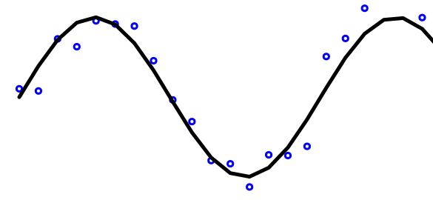
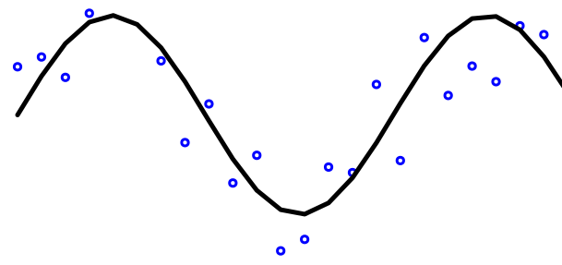
Structural Time Series
+ time
0.5
Seasonal process constructed from bias m_{t}, set of seasonal offsets s_{t}, and length of seasonality d (Durbin 2012)
where
where
Seasonal process defines our block density
0.3
+
-0.3
0.8
=
0.2
where
Main Idea
Methods
Experiments
Notes:
To create the seasonal process, we formulate it as a structural time series.
The time series is constructed from two components, first there is the bias m_t. This is modeled by a random walk, and simple establishes a base in which the seasonal process will be built around.
Next there is a set of d seasonal offsets. d will determine the length of the seasonal pattern, e.g. 4 seasons in a year, 24 hours in a day… The time series enforces a zero sum constraint with gaussian noise, but more intuitively on the right, we can see the offsets will form a sine link shape.
Summing the two components to form c, we complete our definition of the seasonal process. This now leaves us with the task of merging the seasonal process with the block density. We simply define the block density as a random gaussian noise about the seasonal process c. This additional noise parameters allows us to separate the noise due to the seasonal process of a system, from other forms of noise such as from sensors.
This completes are definition of the generative seasonal dynamic stochastic block model. Now we need to discuss how given observed networks as input, how can we infer the underlying seasonal process, driving the network formation?

Slide 7
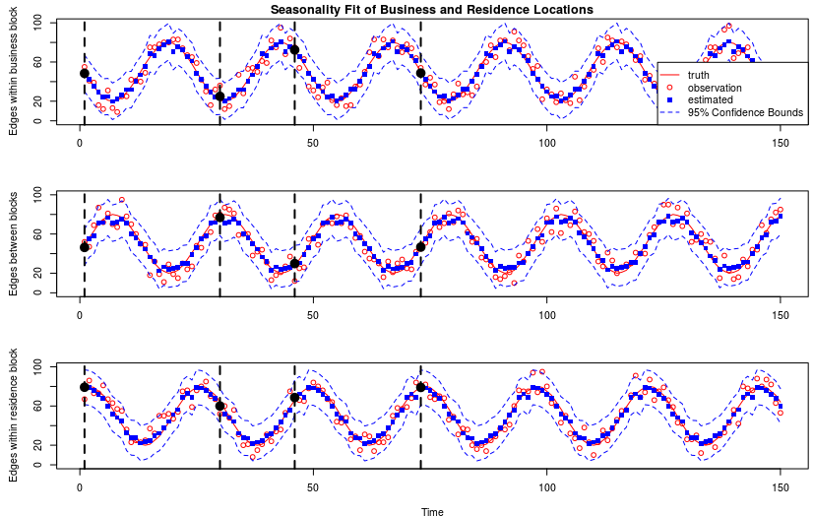
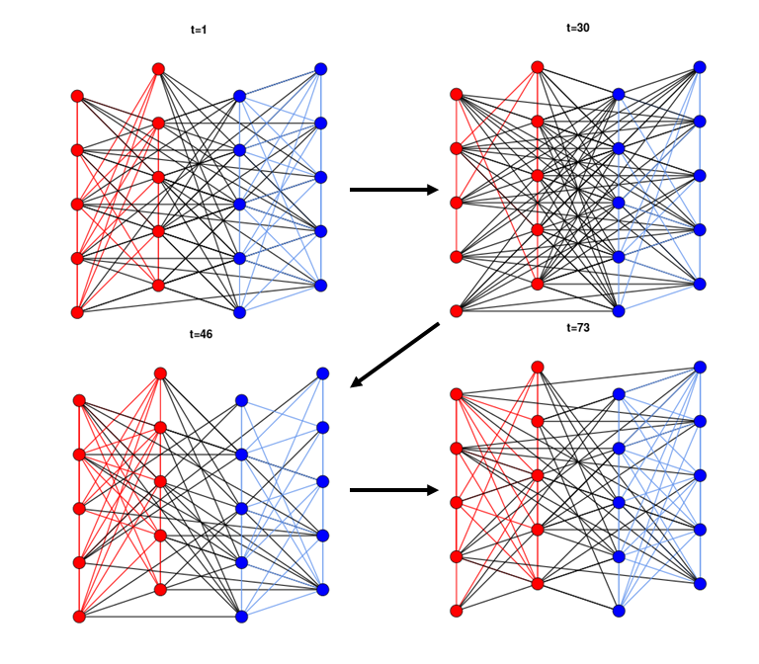
Inference and Learning
Posterior inference by Kalman Filter and State Space Model (Murphy 2012)
Parameter learning by Expectation-Maximization (Bishop 2006)
Main Idea
Methods
Experiments
Notes:
First we can do inference of the seasonal process using a Kalman filter in a state space model. The variance terms also be learned in an expectation maximization routine. The details of the inference is discussed within the publication. The details of the expectation-maximization will be published in a future paper due to space constraints.
In the figures below, we can see an example of our implemented code recovering the underlying seasonal of observed synthetic networks. On the right is a two class network. This leads to three seasonal processes as shown by the three sinusoidal waves on the left. Given number of edges in the observed networks as shown by the red data points, we recover the true underlying seasonal process by the blue squares. As we have a statistical distribution based around gaussian assumptions, we have confidence intervals as well.

Slide 8
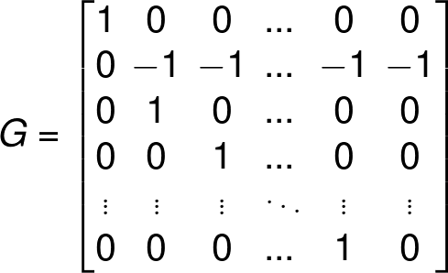
Posterior Inference by Kalman Filter
State space model (Murphy 2012)
Transition model
Observation model
n^{(a,b)} is number of possible edges in block (a,b)
Estimated Posterior
Main Idea
Methods
Experiments
Notes:
Due to time, did not include this slide in final presentation.
This discusses how to reform the time series into a form suitable for Kalman filtering in a state space model form. More details available in the WI ’17 paper.

Slide 9
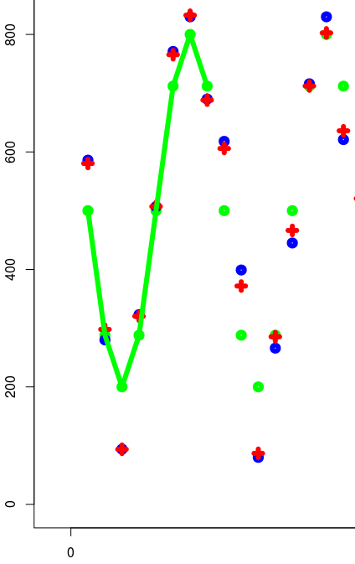
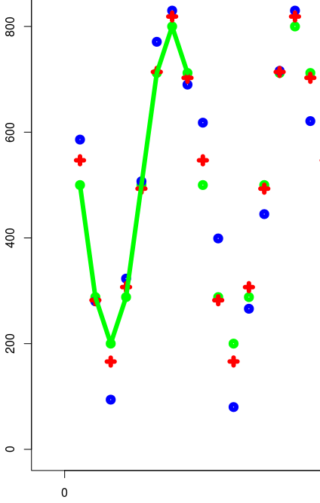
Parameter Learning by Expectation-Maximization
Given initial guesses of variance terms q_{m}^{(a,b)}, q_{s}^{(a,b)}, and r^{(a,b)}
Determines point estimates
Monotonically converges to local minimum
Omitting details for brevity (Bishop 2006)
Number of edges
Number of edges
time
time
Initial Guess
Converged Solution
Main Idea
Methods
Experiments
Notes:
Due to time, did not include this in the final presentation.
EM is an algorithm which iteratively reaches a local minimum point estimate of the variance terms on our model. The changes in the variance terms affect how well the model will fit to the data. In the first figure on the left showing the results of an initial guess of variance parameters before EM, the goal is to have the estimates in red, lie on the truth data in green. If the estimates are lieing on the blue, as shown in the figure, this is bad as we are not recovering the underlying seasonal process as needed. After the EM, we can see many of the estimates are much closer have shifted from overfitting to the blue points, to moving closer to recovering the underlying truth in green.

Slide 10
Synthetic Experiments
Generative procedure creates synthetic networks
3 types, 32 vertices per type, seasonal process of sum of sine waves, length 8 seasonal period
Goal: recover underlying seasonality as we vary…
number of observed seasonal periods
amount of measurement noise
Main Idea
Methods
Experiments
Notes:
At this point in our research, we have complete some initial synthetic experiments to understand the behavior and properties of our model. We run a representative experiment where we give what we feel are average values to different parameters, of three types, 32 vertices per type, seasonal process following sinusoidal curves, and length 8 seasonal period.
The first simple experiment we will show is how effectively we can recover the underlying seasonality, as we have the number of observed seasonal periods. This can give of a sense of how much data will be needed to practice to have good fits.

Slide 11
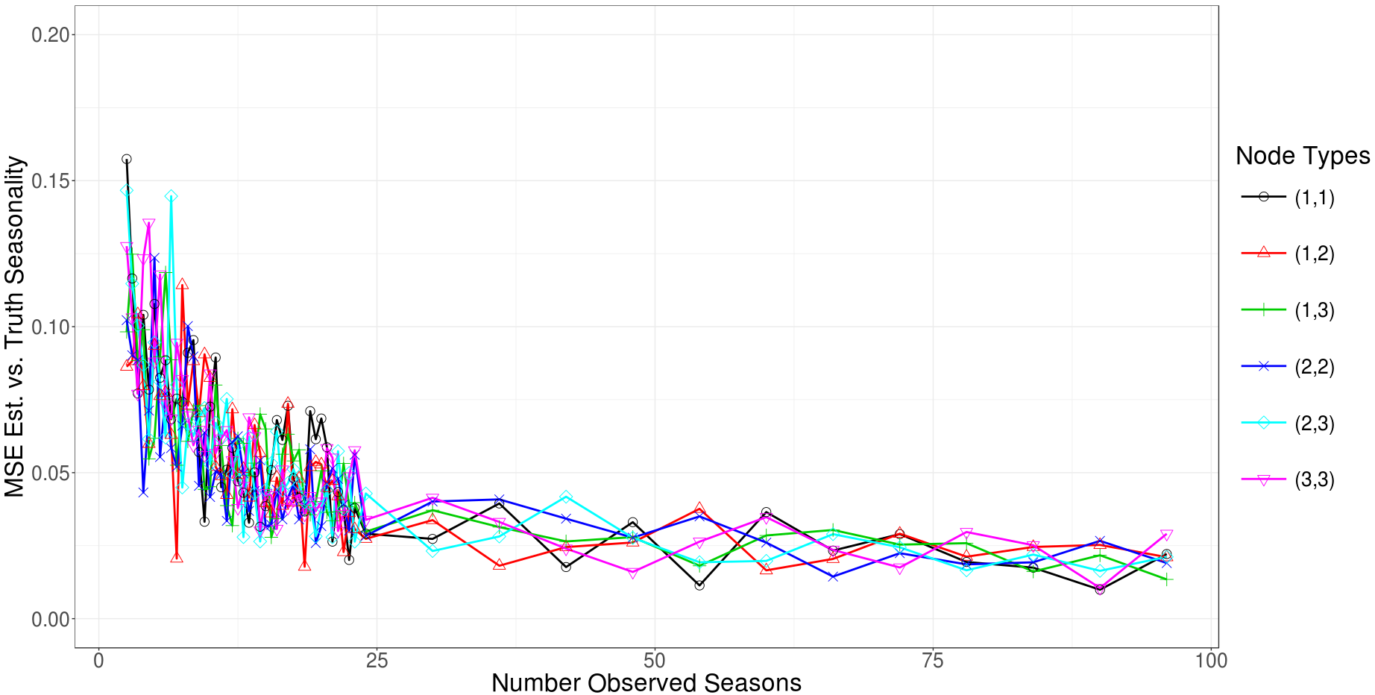
Increasing observed seasonal periods
Main Idea
Methods
Experiments
Notes:
On the x-axis we increase the number of observed periods, so multiples of 8 time steps. On the y-axis is the mean squared error of between the fitted seasonal processes and the truth underlying seasonality. There are six lines following six different seasonal processes based on the node pairings.
As desired, as the number of seasons approaches infinity, the mean squared error approaches zero. For each individual seasonal offset, you observed that specific timestep once each seasonal period. Therefore observing 20-30 seasonal periods, effectively observes 20-30 full data points. As normal with basic machine learning models like linear regression, you can begin being confident in the ability to fit underlying truth data after about 30 data points. This idea is reflected in the platuing mse in range 20-30 periods.

Slide 12
Increasing amount of measurement noise
Main Idea
Methods
Experiments
Notes:
Hoping to remake plot with more data as I do not find very insightful yet.

Slide 13
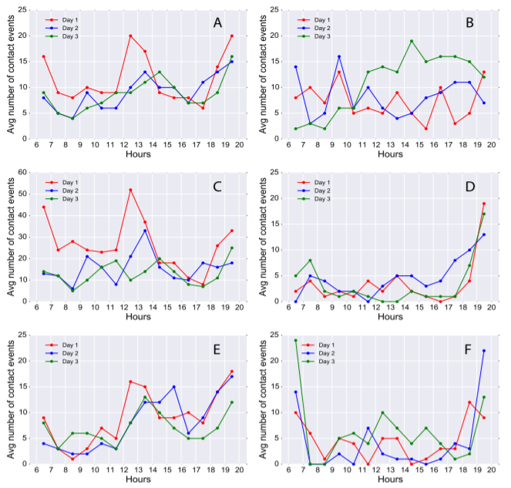
Moving Forward
More synthetic experiments
Sensitivity to hyperparameters
Scalability
Social networks via proximity sensors
Sociopatterns contacts in Kenyan households (Kiti 2016)
Sociopatterns contacts in workplace (Genois 2015)
Reality Common Badge dataset (Olguin 2009)
Geospatial Networks
Geospatial trajectories and points of interest from Columbus Large Image Format (CLIF)
Kiti (2016)
Main Idea
Methods
Experiments
Notes:
Moving forward I am excited to apply the model on real datasets. There are two different types of real datasets we have found so far. First there are several public dynamic social network datasets such from socio patterns and reality commons. Looking at one by Kiti 2016 in particular, he creates a social network in several Kenyan households. In the figure on the right, figures B through F each represent the amount of contact across time for each household. For C-F, we can see the paper repeats closely for each day, providing evidence that and underlying seasonality is driving the amount of contact events.

Slide 14
References
CLIF007 dataset, www.sdms.afrl.af.mil/index.php?collection=clif2007
Supplementary Material of Juliette Stehlé, Nicolas Voirin, Alain Barrat, Ciro Cattuto, Lorenzo Isella, Jean-François Pinton, Marco Quaggiotto, Wouter Van den Broeck, Corinne Régis, Bruno Lina and Philippe Vanhems. PLOS ONE 6(8): e23176 (2011). doi:10.1371/journal.pone.0023176
Holland, Paul W., Kathryn Blackmond Laskey, and Samuel Leinhardt. "Stochastic blockmodels: First steps." Social networks 5.2 (1983): 109-137.
Xu, Kevin S., and Alfred O. Hero III. "Dynamic Stochastic Blockmodels: Statistical Models for Time-Evolving Networks." SBP. 2013.
Yang, Tianbao, et al. "Detecting communities and their evolutions in dynamic social networks—a Bayesian approach." Machine learning 82.2 (2011): 157-189.
Durbin, James, and Siem Jan Koopman. Time series analysis by state space methods. Vol. 38. OUP Oxford, 2012.
Main Idea
Methods
Experiments
Notes:
Thank you for listening to my talk! A good paper for those interested in dynamic network modeling using stochastic block models, Xu-Hero (4) is my favorite of the citations. Durbin (6) and Murphy (7) are strong, detailed textbooks on the inference and learning core concepts.

Slide 15
References
Murphy, Kevin P. Machine learning: a probabilistic perspective. MIT press, 2012.
Bishop, Christopher M. Pattern recognition and machine learning. springer, 2006.
Kiti, Moses C., et al. "Quantifying social contacts in a household setting of rural kenya using wearable proximity sensors." EPJ data science 5.1 (2016): 1-21.
Génois, Mathieu, et al. "Data on face-to-face contacts in an office building suggest a low-cost vaccination strategy based on community linkers." Network Science 3.3 (2015): 326-347.
Olguín, Daniel Olguín, et al. "Sensible organizations: Technology and methodology for automatically measuring organizational behavior." IEEE Transactions on Systems, Man, and Cybernetics, Part B (Cybernetics) 39.1 (2009): 43-55.
Main Idea
Methods
Experiments

